Slide 1


Evolutionary Architectures con .NET e MS Azure
alberto.acerbis@intre.it

Slide 3


You have the permission to sleep … but the speaker has the right to question you

Slide 4

Can you help me?
I need a distributed system. Can you help me?

Slide 5


The Fear for Distributed Architectures
Why have architects struggled with decisions in distributed architectures?
Because Software Architecture is the stuff you can’t Google Bing answers for

Slide 6

Ecosystem Change
How is long-term planning possible under constant change?

Slide 7

Evolutionary Architecture
An Evolutionary Architecture supports guided incremental change across multiple dimensions.

Slide 8

Solutions
A monolithic architecture is a traditional model of a software program, which is built as a unified unit that is self-contained and independent from other applications.
Microservices are self-contained small services that handle specific business functions within clearly defined boundaries known as Bounded Context.

Slide 9

Traps
Database Refactoring
Choreography
Contract Testing
Continuos Delivery
Evolvability and Experimentation
Culture of Experimentation

Slide 10

Unknow Unknows
Risk comes from not knowing what you are doing
(Warren Buffet)
If you are think good architecture is expensive, try bad architecture

Slide 11
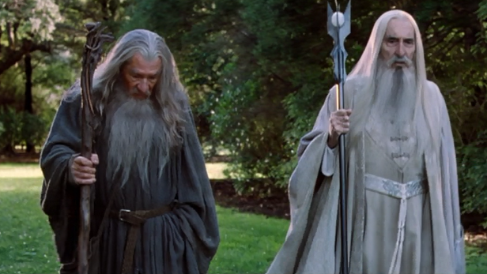
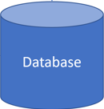
Incremental
Accounts
Payments
Admin
Sales
Warehouses
Purchases
In-Memory Event Bus

Slide 12

What is a Module?
Low Coupling
Each module should be independent of other modules in the system
High Cohesion
Components of the module are all related thus making it easier to understand what module does as a self-contained subsystem

Slide 13
Show Me the Code!

Slide 14

Guided
Fitness Functions
An evolutionary computing fitness function characterizes how close a solution is to desire result
An architectural fitness function characterizes how close a system is to the desired architectural characteristics
The code must be maintanable!
(What does that mean?)
Outcomes not Implementations

Slide 15
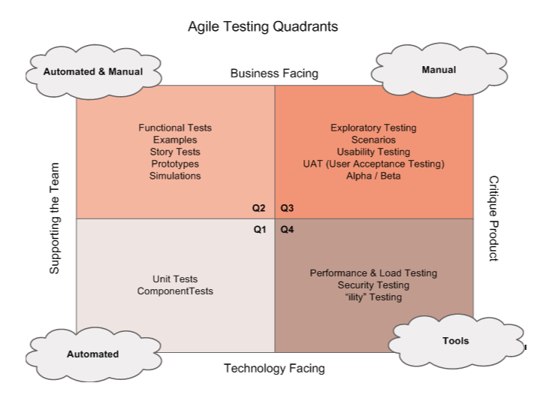

Test – Test – Test – Test …. Test!

Slide 16
Show Me the Code!

Slide 17

Multiple Dimensions
Application
Operations
Essential
Accidental

Slide 18
Principles
Last Responsible Moment
Architect and develop for evolvability
Postel’s Law
Conway’s Law
Take decisions at the last responsible moment, because you have the most information
You cannot change a system you don’t understand
Be conservative in what you send, be liberal in what you accept
Organizations which design systems are constrained to produce designs which are copies of the communication structures of these organizations.

Slide 19
Laws of Software Architecture
First Law
Corollary 1
Second Law
Everything in software architecture is a trade-off
If an architect thinks they have discovered something that isn’t a trade-off, more likely they just haven’t yet identified the
trade-off
Why is more important than how

Slide 20
Show Me the Code!

Slide 21
Ready to Deploy
App Service
AKS
Container Apps

Slide 22
Why Container Apps?
Serverless
Costs
- Enables developers to build and run application code without provisioning or managing servers or backend infrastructure
- Easy Configuration
- Zero Maintenance Effort
- Pay as you go

Slide 23
Show Me the Code!

Slide 24

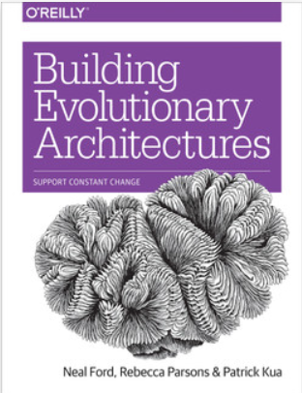
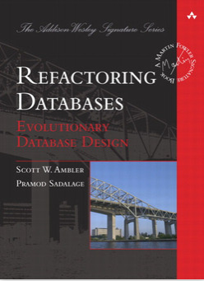


Suggestions
No Silver Bullet - Essence and Accident in Software Engineering
Fitness function-driven development
Five Level of Ignorance

Slide 25
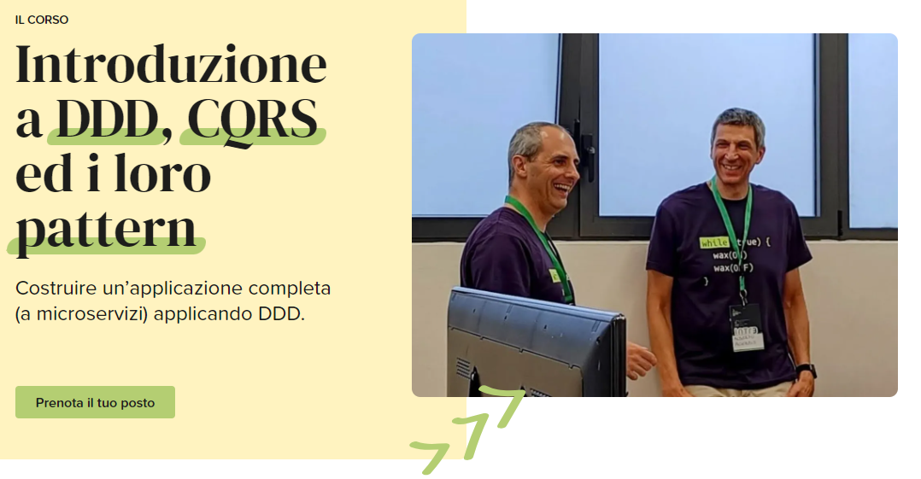







Thank You!!!
alberto.acerbis@intre.it
https://github.com/brewup
https://github.com/cqrs-muflone
https://github.com/ace68
Alberto Acerbis

